Slide 1
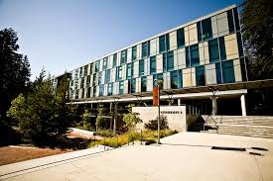
UCSC MASTERS PROGRAM IN APPLIED ECONOMICS AND FINANCE
January 10, 2024
These slides will be posted at https://economics.ucsc.edu/academics/graduate-program/masters/admissions/index.html

Slide 2
Program structure and overview
One-year program (9 months + 3 weeks required math camp)
Capstone exam
The program combines core training in economic theory with meaningful applications that students are likely to face in their professional careers in business, government, non-profit.
More applied orientation than a typical M.A. program in economics.
More training in economics, statistics, and econometrics than most M.B.A. programs.
Stresses mastery of core principles in micro and macroeconomics and finance.
Each student learns how to solve practical problems and to communicate the results clearly.
The emphasis on advanced econometric techniques, statistical software packages, and large-scale financial and microeconomic datasets.

Slide 3
Where do our students go after graduation?
Business

Slide 4
Where do our students go after graduation?
Government
State Bar of California
County of Fresno
Judicial Council of California
Louisiana Department of Health
Federal Reserve Bank of San Francisco
Sunnyvale Community Services
City of Pasadena
State Compensation Insurance Fund
Universities
University of Calgary
Stanford Institute for Economic Policy Research
UCSC
NYU

Slide 5
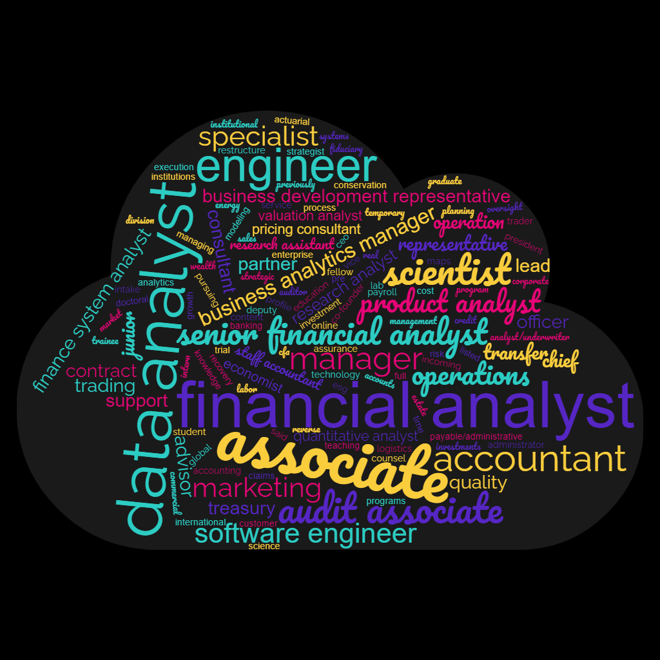
And what do they do there?

Slide 6
Requirements
Math camp (can test out)
9 5-unit courses
3 labs (2 required, one optional)
Professional development seminars
Capstone exam in one of the three tracks
Applied Economics
Finance
General

Slide 7
Courses offered (this year, subject to change): Fall
All:
Micro Analysis (200), Finance 1 (233), Applied Econometrics 1 (216), Stata lab (294A);
*5-unit courses are in bold

Slide 8
Courses offered (this year, subject to change): Winter
All:
Choice of Econometrics (217 or 114/114L), R lab (294A), Professional development seminar (294B);
Applied track:
Public policy analysis (259B), an elective
Finance track:
Corporate Finance (235), Financial Engineering (236)
General track:
Financial Engineering (236), an elective
*5-unit courses are in bold

Slide 9
Courses offered (this year, subject to change): Spring
All:
Macroeconomic analysis (202), Python lab (294A), Professional development seminar (294B).
Applied track:
Micro Applications (201), an elective
Finance track:
International Financial Management (231), Financial Institutions and Markets (234)
General track:
Micro Applications (201) , an elective
*5-unit courses are in bold

Slide 10
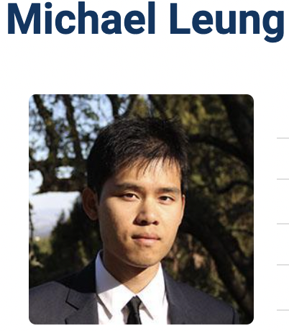
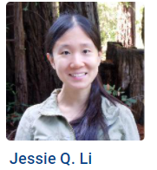
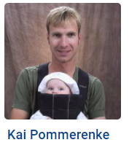
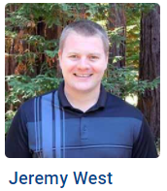
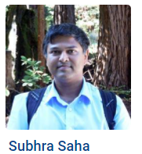
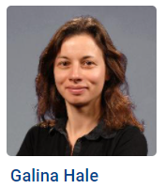
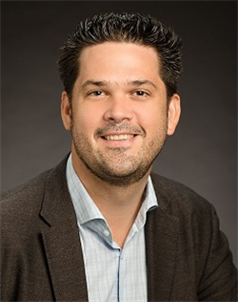
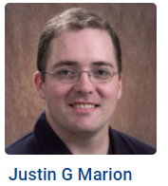
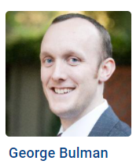
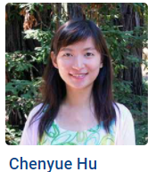
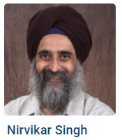
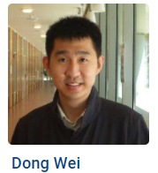
Faculty (teaching this year)
Peter Christensen

Slide 11
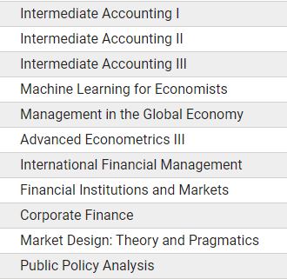
Electives options
Economics
Applied Math
Computer Science and Engineering
Environmental Studies
Statistics

Slide 12
Electives options
Economics
Applied Math
Computer Science and Engineering
Environmental Studies
Statistics

Slide 13
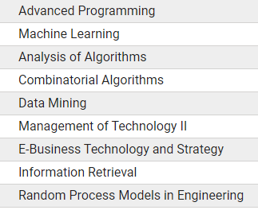
Electives options
Economics
Applied Math
Computer Science and Engineering
Environmental Studies
Statistics

Slide 14
Electives options
Economics
Applied Math
Computer Science and Engineering
Environmental Studies
Statistics

Slide 15
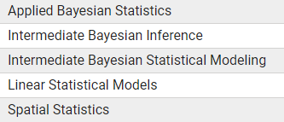
Electives options
Economics
Applied Math
Computer Science and Engineering
Environmental Studies
Statistics

Slide 16
Professional development seminar
Alumni speakers
CV writing
Job search
Other professional skills

Slide 17
Three tracks: capstone exam requirements
Applied economics
200, 201, 216, 217, 259B
Must complete 4 of 5 sections of the capstone exam
Finance
233, 236, 231, 234, 235
Must complete 4 of 5 sections of the capstone exam
General
200, 201, 233, 236

Slide 18
Application considerations (apply here)
Deadline
Two deadlines - early: February 28, final deadline: April 15
Is there financial aid available?
Yes! Students enrolled in the program may receive $1,000-6,000 in aid, merit-based.
TA positions may be available, but not guaranteed
What score do I need to get on the GRE?
No longer required, but if you are taking it, please submit results
What is the average GPA requirement?
The average GPA of admitted students is 3.33 The minimum GPA accepted is 3.0

Slide 19
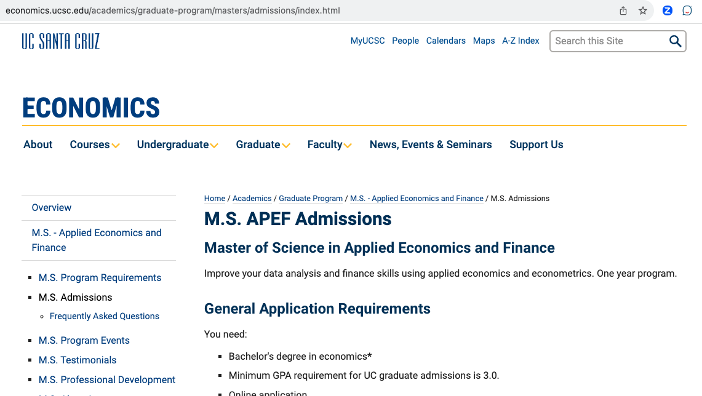
Where to get your questions answered?
Program web site (in progress of update): https://economics.ucsc.edu/academics/graduate-program/masters/index.html
Galina Hale - program director gbhale@ucsc.edu
Graduate program coordinator ecngrdcr@ucsc.edu

